Slide 1

Group 14
Dividend Income Tracker
Team members:
Aman Patel (20012609)
Divyang Sarangi (20009524)
Shloka Singh (20015697)
Vatsal Patel (20010794)

Slide 2


Introduction
Introducing our Dividend Income Tracker, a specialized tool designed for investors focusing on dividend income.
This package enables you to effortlessly track, project, and analyze your dividend payments.
With features like historical data retrieval, future income projections, and tax impact analysis, our tracker offers comprehensive insights into your investments, helping optimize your dividend strategy effectively.

Slide 3




Industry Applications
of Dividend Income Tracker
Financial Services
Enhances portfolio management and client reporting.
Educational Institutions
Teaches investment strategies through practical tools.
Retirement Planning
Forecasts stable income for retirees.
A closer look into enhancing Dividend Management Across Diverse Sectors
Personal Finance
Manages and projects personal investment income.

Slide 4
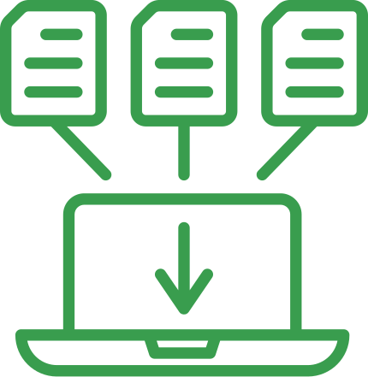


Module Outline
Key Modules for Effective Tracking
Dividend Data Retrieval
Income & Tax Analysis
Visualization
Fetches historical dividend data using yfinance.
Projects dividend income and assesses tax impacts efficiently.
Creates charts to visually represent dividend data.

Slide 5

Data Collection: Utilizes ‘yfinance’ to retrieve historical dividend data for selected stocks, ensuring comprehensive access to past dividend payouts.
Data Aggregation: Aggregates dividend information over specified timeframes, allowing for detailed analysis of historical trends and performance.
Foundation for Analysis: Acts as the essential base for further dividend-related financial projections and in-depth analysis within the application.
Dividend Data Retrieval

Slide 6
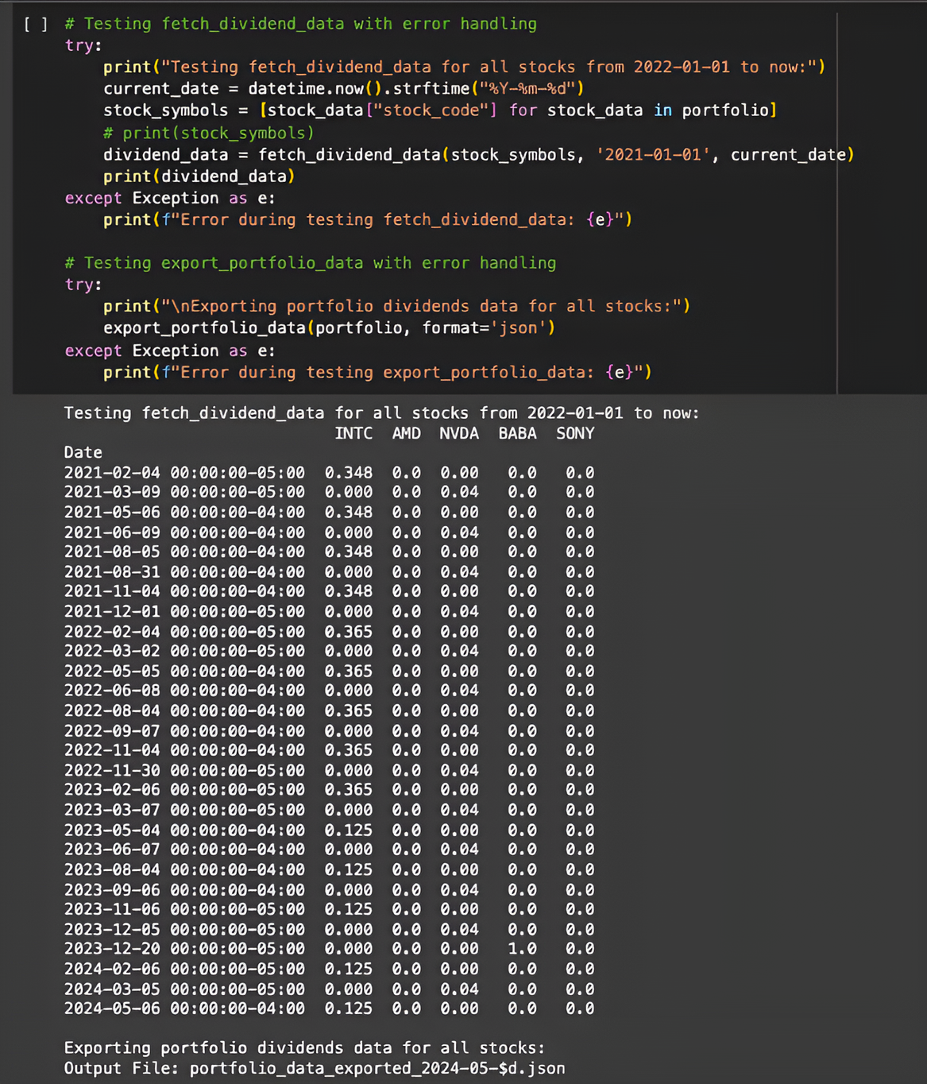
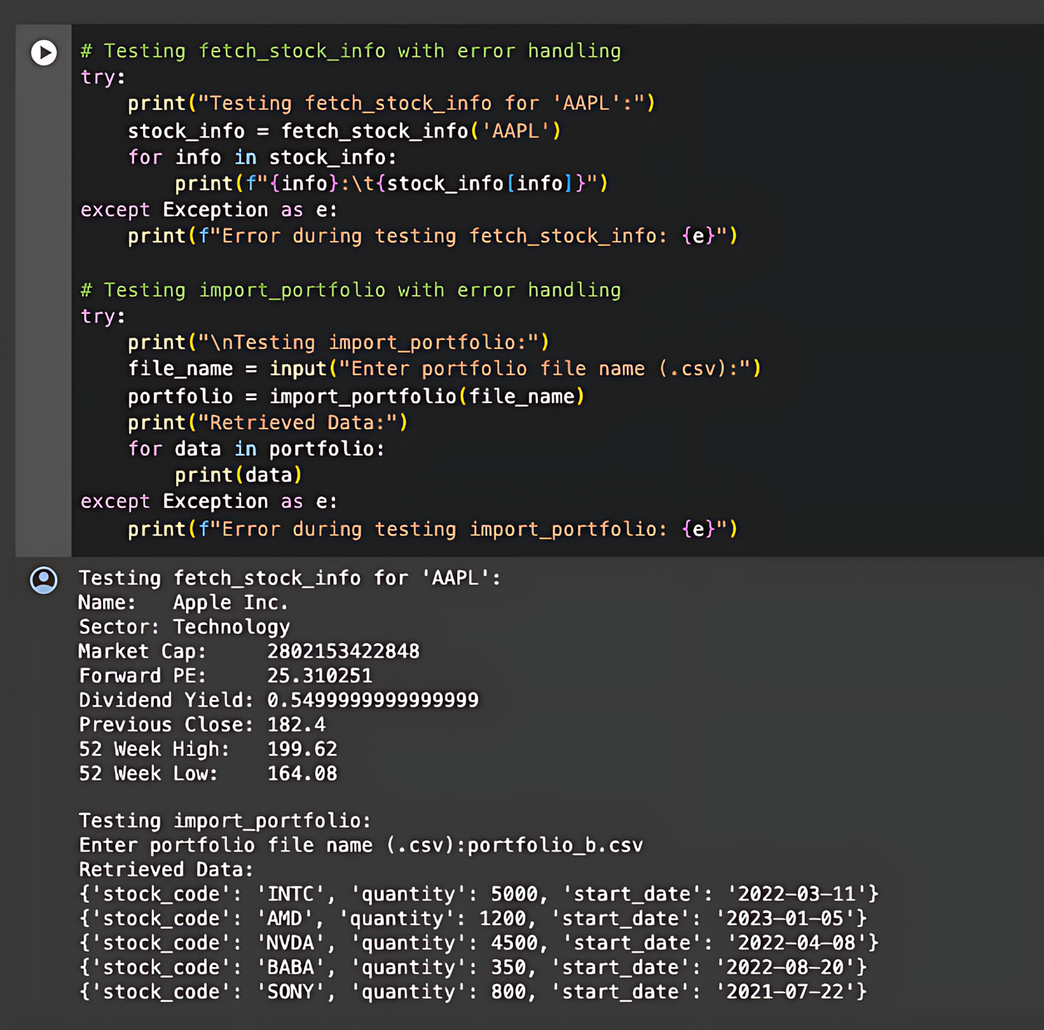

Slide 7

Future Income Projection: Leverages historical dividend data to forecast future dividend income, enhancing financial planning accuracy.
Tax Impact Calculation: Analyzes the tax implications of dividends across multiple jurisdictions, ensuring comprehensive understanding of tax liabilities.
Strategic Financial Planning: Offers detailed insights into net investment benefits, aiding investors in optimizing their financial strategies.
Income & Tax Analysis

Slide 8
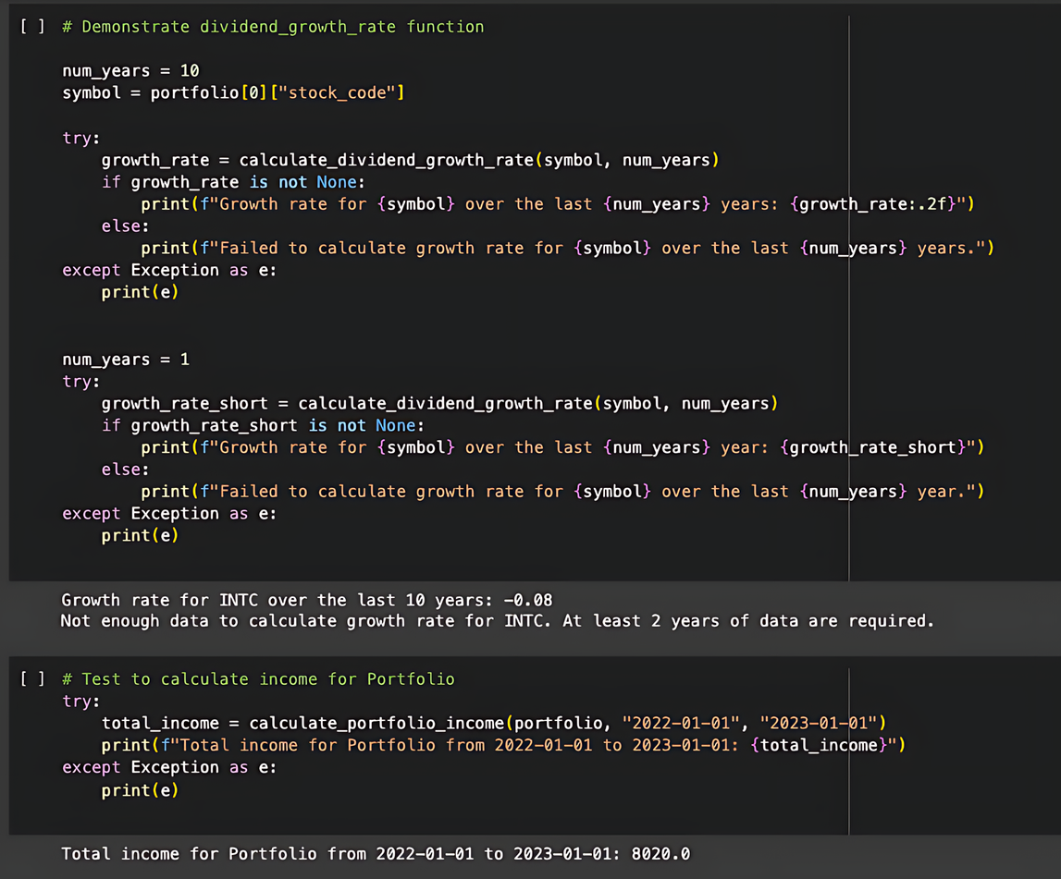
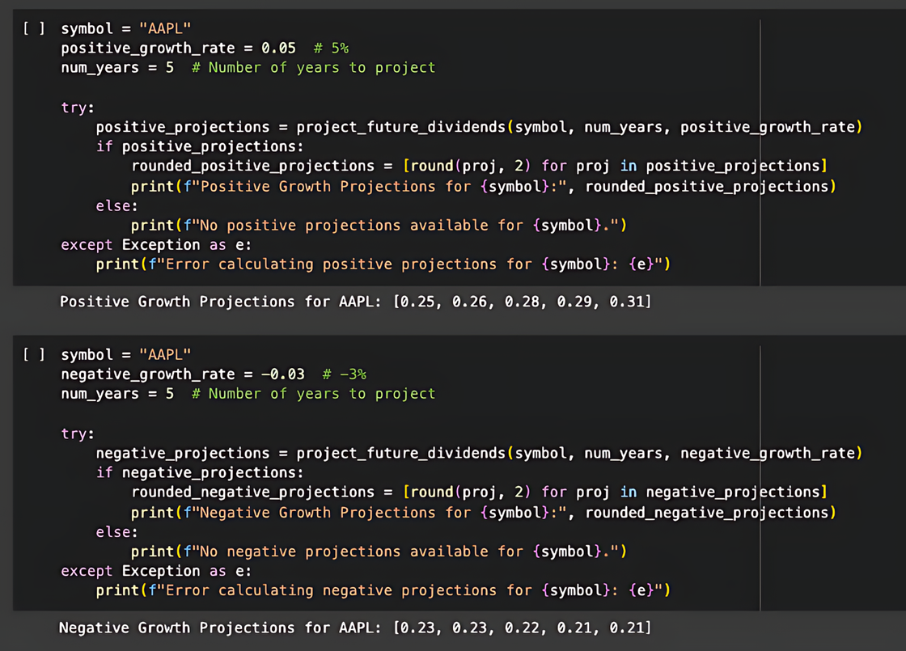

Slide 9
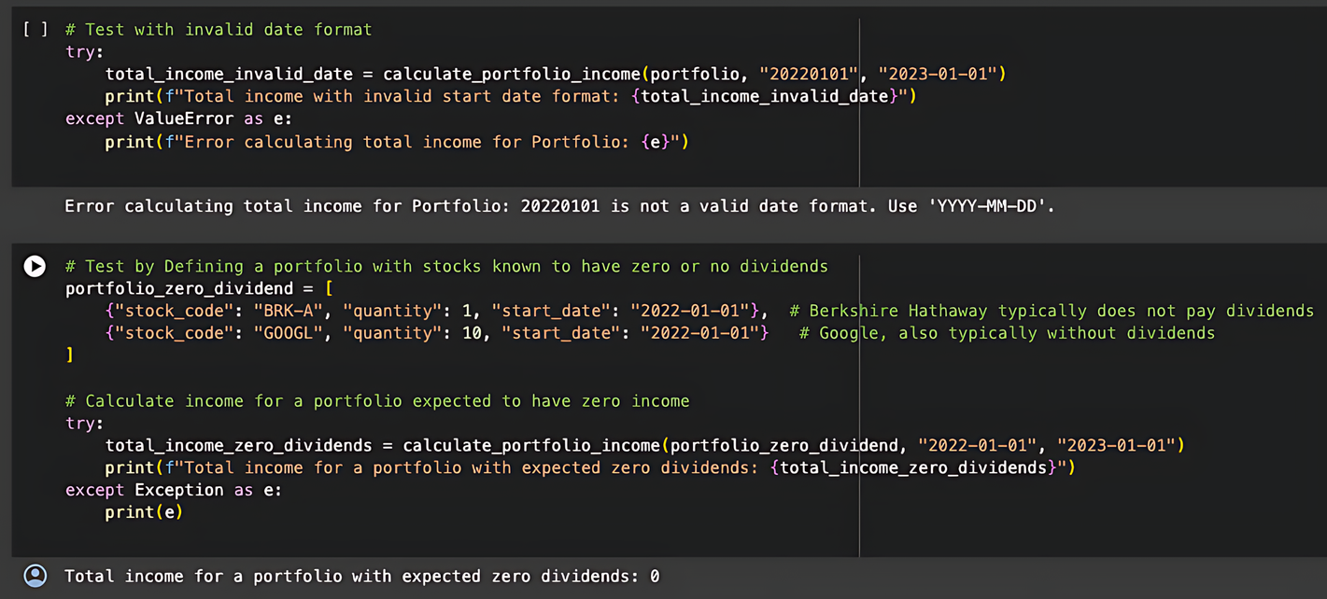
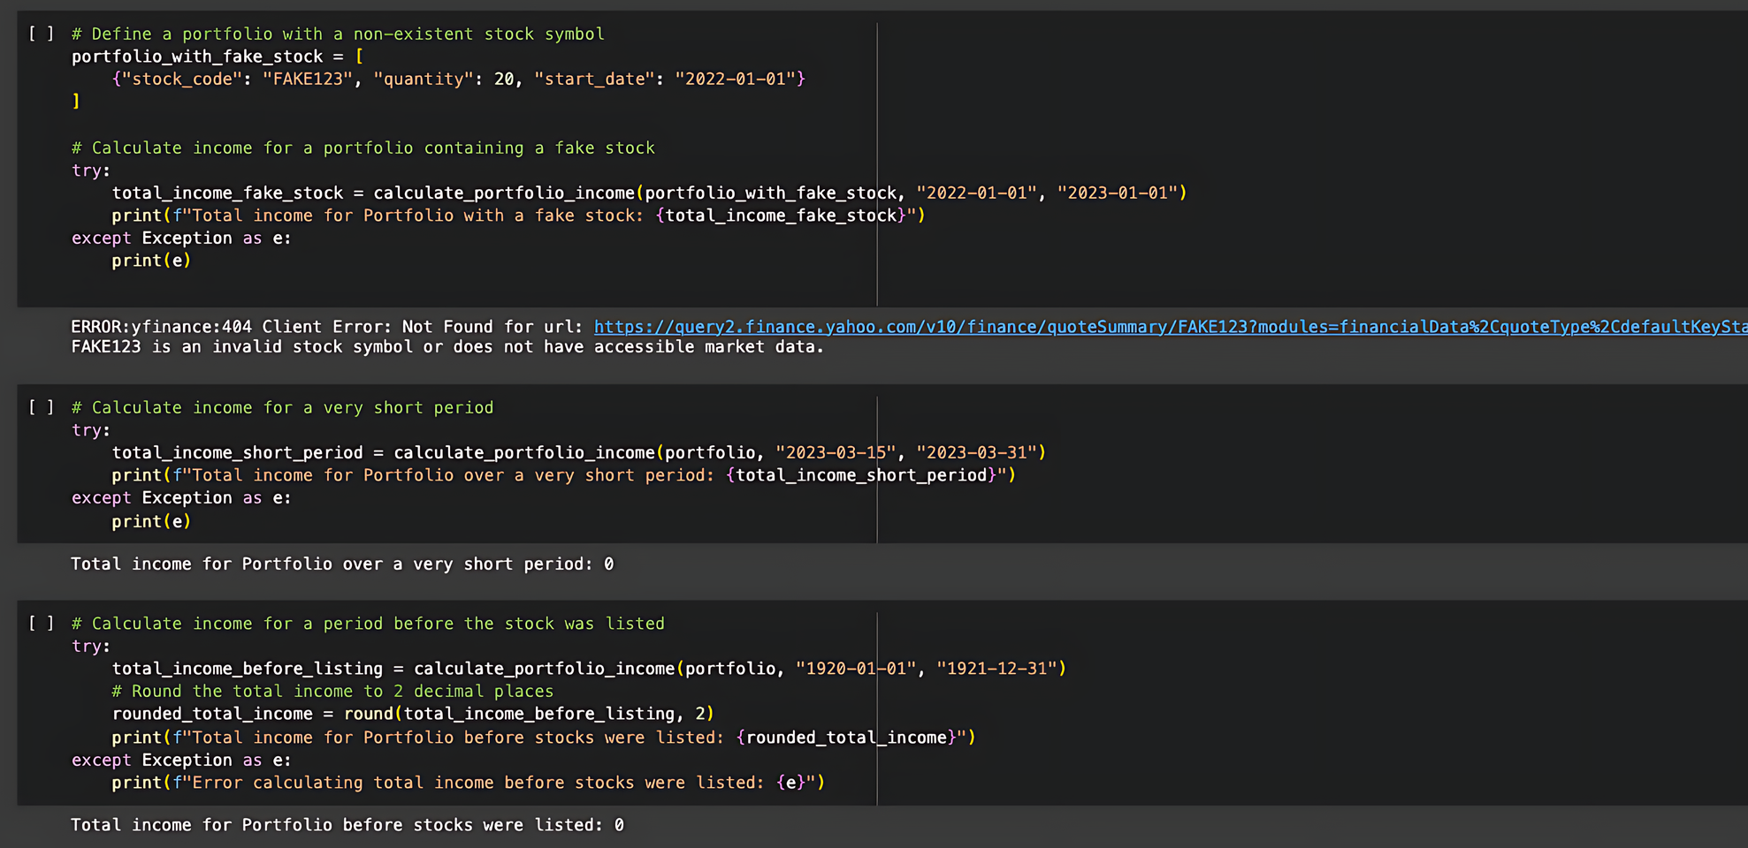

Slide 10
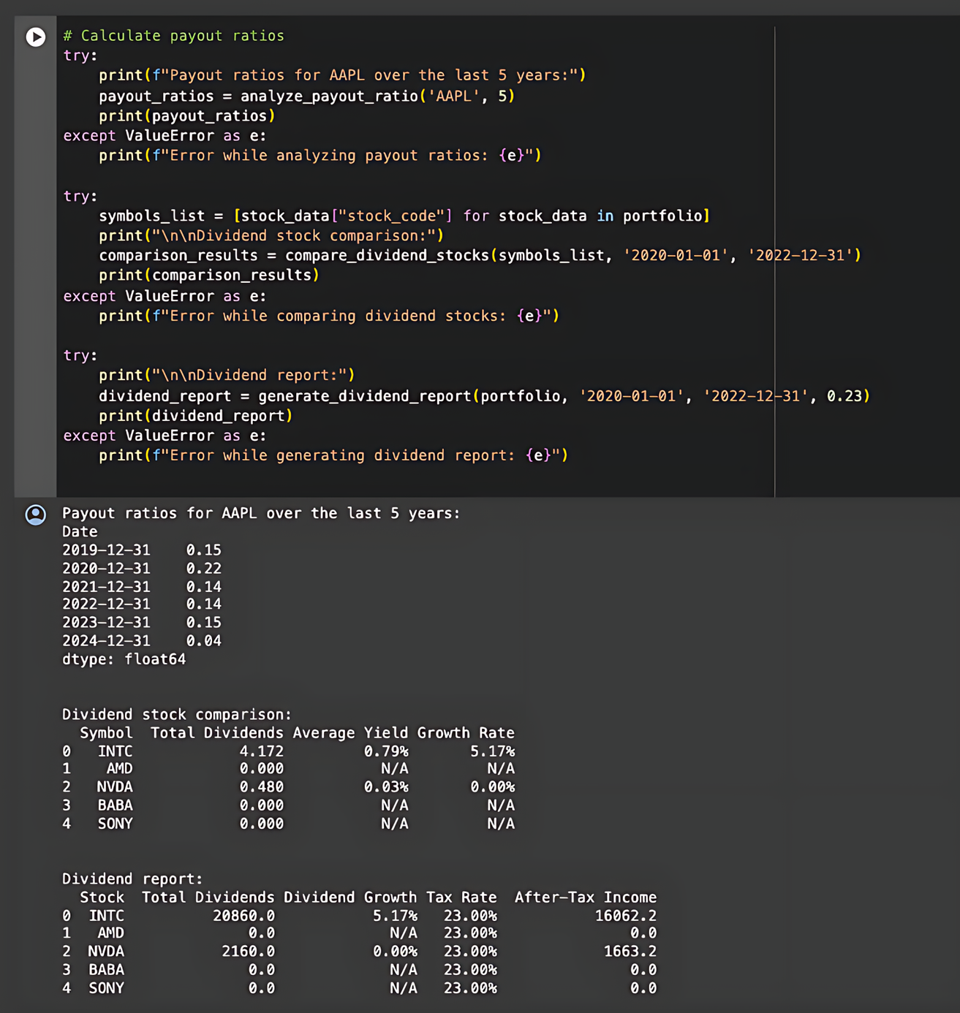
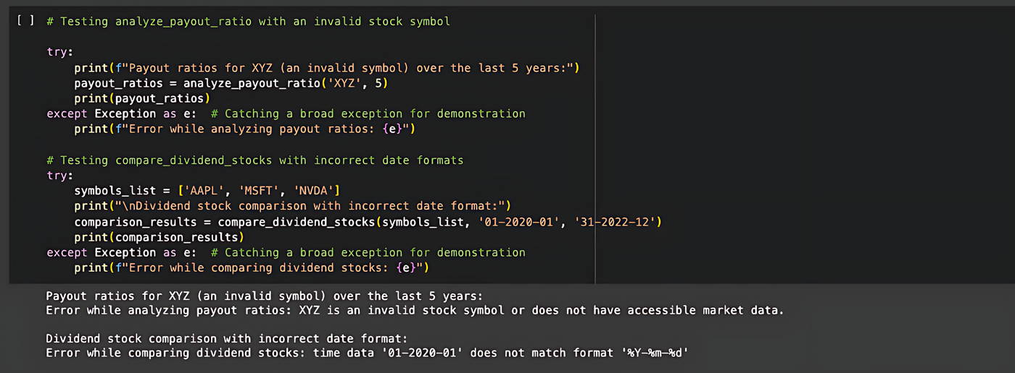

Slide 11

Diverse Data Visualizations: Provides graphs for future dividend projections, payout ratios, and total dividends, enhancing visual analysis.
Comparative Insights: Facilitates easy comparison of stocks through visual representations of average yields and growth rates.
Informed Decision-Making: Empowers users to make well-informed investment choices based on clear, graphical data trends.
Visualization

Slide 12
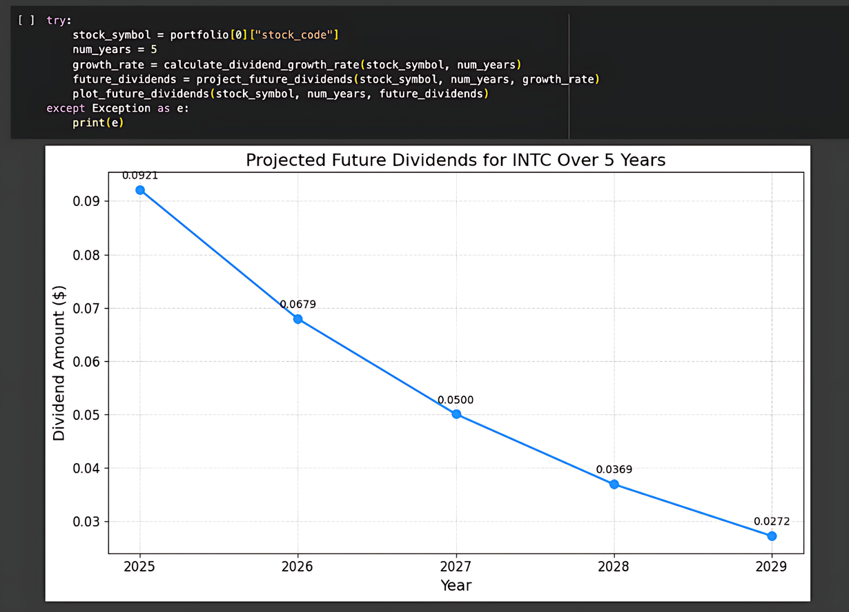
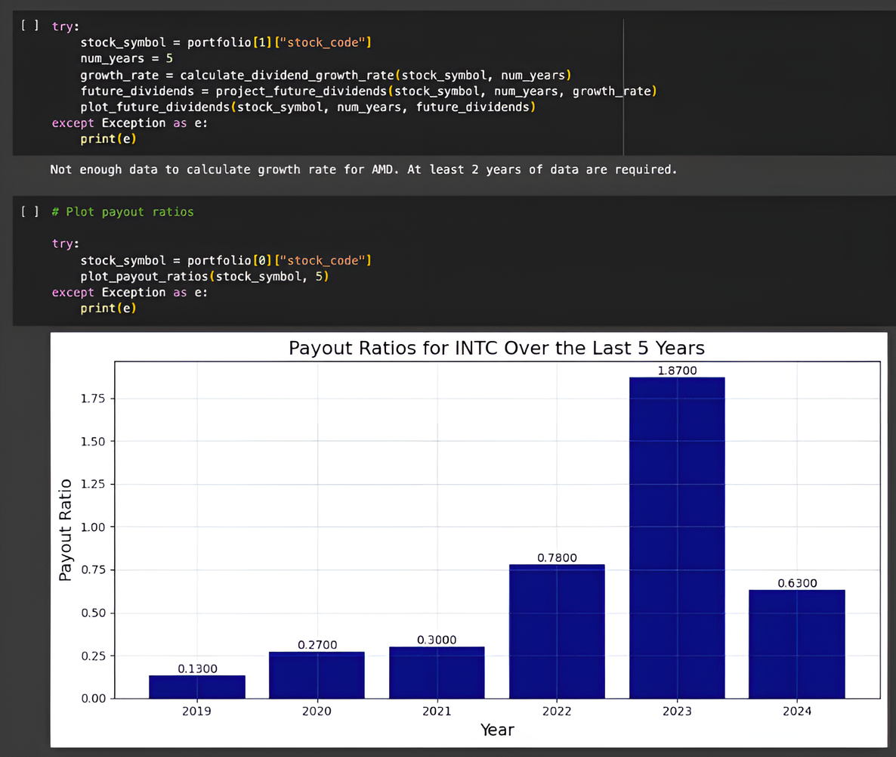

Slide 13
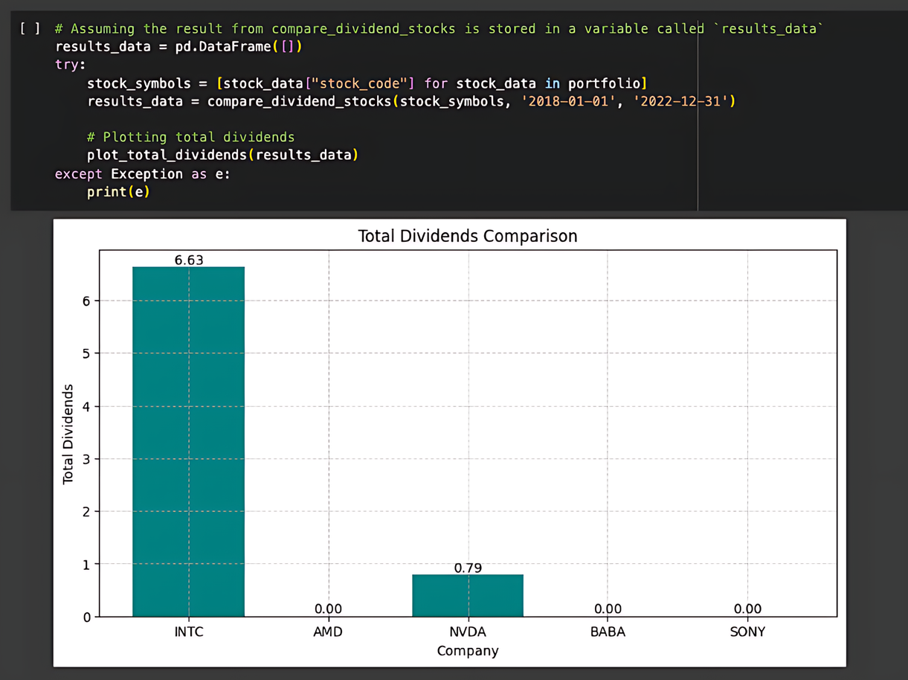
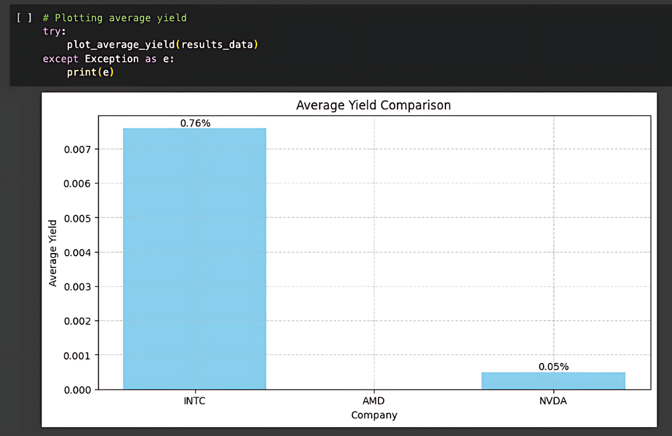
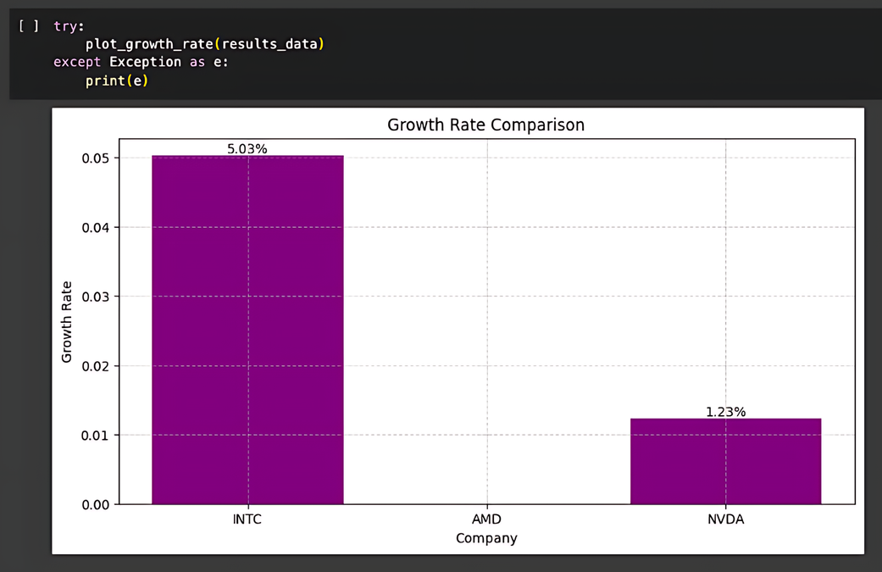

Slide 14

Conclusion
In conclusion, the Dividend Income Tracker offers investors a robust suite of tools for detailed analysis and visualization of dividend data.
Featuring modules for data retrieval, income projection, tax analysis, and visual representation, it provides comprehensive insights into dividend sustainability, future earnings, and tax impacts.
This package empowers investors to enhance their strategies in dividend-centric portfolios by delivering clear, actionable analyses and visual data across various stocks and periods.

Slide 15

Thank You

